Slide 1
JacKpot
Group j

Slide 2
Prepared By:
Name Roll No.
Rupesh Chaulagain
Kushal Kattel 07
Paras Tiwari 11
Under the guidance of Mr. Debindra Bhandari

Slide 3
Introduction
The project “Jackpot” is an console application developed using C-Programming language.
The application provides a platform to earn a money playing a simple Jackpot Game.
Money earned within games can be used to continue playing the game .

Slide 4
Purpose
It provides entertainment to the user.
This application is for simple illustration of C program.
It is devolved to full fill the requirement of syllabus as the part of exam.

Slide 5
Objectives
This Project in C language of Jackpot game is a simple console application. In this project, you can play the “Jackpot” just to earn money.
You have to earn money to keep playing the games.
The main objective is to provide entertainment to users.

Slide 6
Features & About the Project?
This Jackpot game is similar to the concept of jackpot, but money earned cannot be used outside.
There is an help section in the main menu where it gives an instruction for how to play.
Players will able to check their result after game gets over.

Slide 7
Testing & Screenshots
Testing is the major control measure used during software development. Its basic function is to detect errors in the software. During requirement analysis and design, the output is a document that is usually textual and no executable. After the coding phase, computer programs are available that can be executed for testing purpose. This implies that testing not only, has to uncover errors introduced during coding, but also errors introduced during previous phase. Thus the goal of testing is to uncover the requirements, design and coding errors in the programs. So after testing the outputs of my project are as follows:

Slide 8
Main Menu:

Slide 9
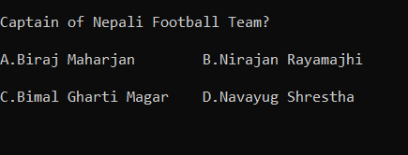
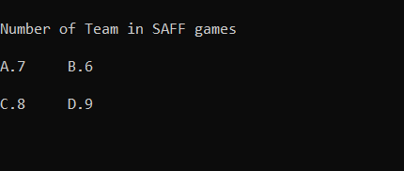
Quiz for earning:

Slide 10
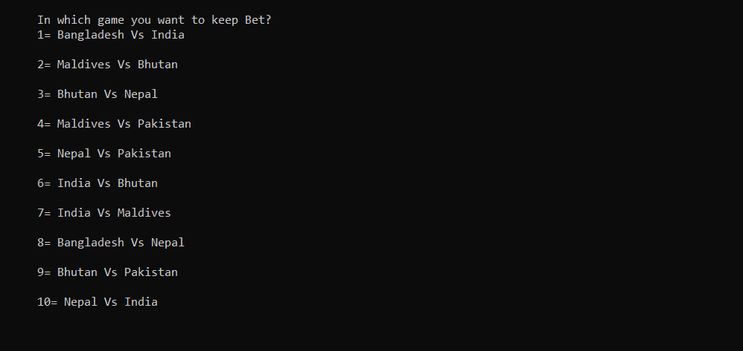
List of Matches:

Slide 11
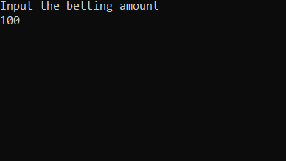
Betting Process:

Slide 12
Conclusion
This project is just a simple example of c programming and its uses. This game can be a more interesting
and enjoyable after some modification and additional features.

Slide 13


